Slide 1
Programming fundamentals
Lecture 23: Stream input/output, Introduction to file handling, open a file for I/O, file modes

Slide 2
Recap
Dynamic array 1D
Dynamic array 2D

Slide 3
Agenda
Streams
Input/output stream
Intro to file handling
Why files?
Open a file
Different modes of opening a file
Opening a file for input
Opening a file for output (with trunc and append mode)
Close a file

Slide 4
Stream
C++ I/O occurs in streams, which are sequences of bytes.
In input operations, the bytes flow from a device (e.g., a keyboard, a disk drive, a network connection, etc.) to main memory.
In output operations, bytes flow from main memory to a device (e.g., a display screen, a printer, a disk drive, a network connection, etc.).
Input device
Program
Flow of bytes
Output device
Program
Flow of bytes

Slide 5

Why files?
Storage of data in memory is temporary
Files are used for persistent data storage
Computers store files at secondary storage such has hard disk
C+ views each file simply as a sequence of byters.
Each file ends with an end of file marker

Slide 6
Contd..
The bytes could represent characters, raw data, graphics images, digital speech, digital video or any other information an application may require.
The system I/O mechanisms should transfer bytes from devices to memory (and vice versa) consistently and reliably.
Such transfers often involve some mechanical motion, such as the rotation of a disk or a tape, or the typing of keystrokes at a keyboard.

Slide 7
Contd..
The bytes could represent characters, raw data, graphics images, digital speech, digital video or any other information an application may require.
The system I/O mechanisms should transfer bytes from devices to memory (and vice versa) consistently and reliably.
Such transfers often involve some mechanical motion, such as the rotation of a disk or a tape, or the typing of keystrokes at a keyboard.
The <iostream> header, which declares basic services required for all stream-I/O operations. The <iostream> header defines the cin, cout
The <iomanip> header declares services useful for performing formatted I/O with socalled parameterized stream manipulators, such as setw and setprecision.
The <fstream> header declares services for file processing.

Slide 8
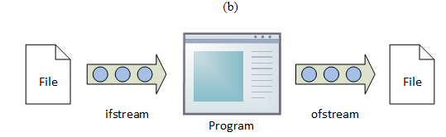
ifstream
Input File Stream. The "i" stands for input and the "f" stands for file; so, a stream object from which data may be read.
ofstream
Output File Stream. The "o" stands for output and the "f" stands for file; so, a stream object to which data may be written.
fstream
File Stream. The "f" stands for file but there is no indication of direction; so, a stream object that allows both reading and writing.

Slide 9
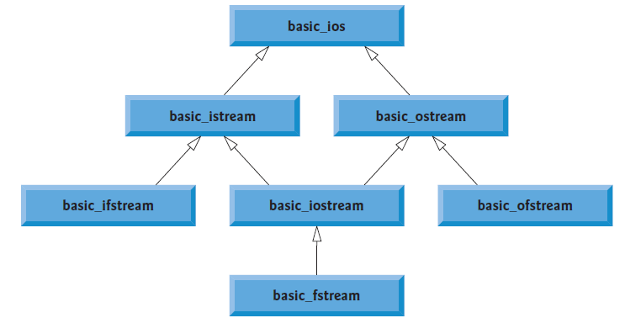
fstream has both ifstream and ofstream

Slide 10
File I/O
To perform file processing, header <iostream> and <fstream> must be included.
When a file is opened, an object is created and stream is associated with the object

Slide 11
For both Input/output
For Input only
For Output only
#include<iostream>
#include<fstream>
using namespace std;
int main()
{
return 0;
}
#include<iostream>
#include<ifstream>
using namespace std;
int main()
{
return 0;
}
#include<iostream>
#include<ofstream>
using namespace std;
int main()
{
return 0;
}

Slide 12
Fstream objects
Unlike the console stream objects that are ready for use as soon as the program starts, instances of the <fstream> classes must be instantiated and associated with a file before a program is able to use them.
Can use out only to read from file (Input)
You cannot write to a file using out
Can use in only to read from file (Input)
You cannot write to a file using in
ifstream in;
ofstream out;
#include<iostream>
#include<fstream>
using namespace std;
int main() {
ifstream in;
ofstream out;
return 0;
}

Slide 13
Open a file
We can open the file for input/output by creating an ifstream/ofstream/fstream object.
Two arguments are passed to the object’s constructor—the filename and the fileopen mode

Slide 14
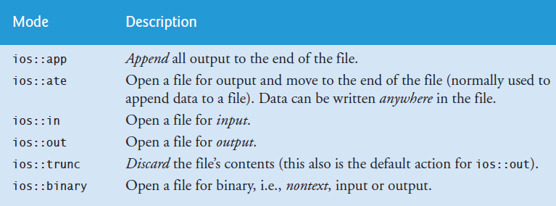
File modes

Slide 15
Opening a file for input

Slide 16
Open a file (using ifstream)
Two arguments are passed to the object’s constructor—the filename and the fileopen mode
ifstream in( "clients.txt", ios::in );
#include<iostream>
#include<fstream>
using namespace std;
int main() {
ifstream in("clients.txt", ios::in);
return 0;
}
Before opening a file for input, the file MUST exist!

Slide 17
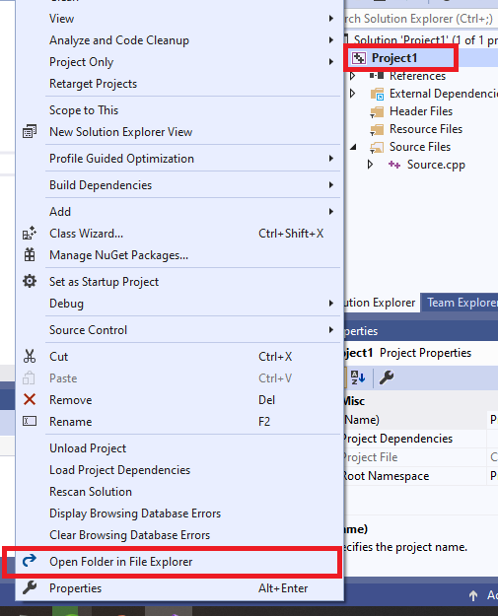
ifstream in( "clients.txt", ios::in );
Here you specify the path of file! i.e. path of location where the file resides
If no path is specified, instead only file name I written, then the compiler assumes that the file resides in your current project directory (folder where your C++ current project is created on disk)
See this figure to open that folder. Right click on Project and then choose “Open Folder in File Explorer” from the drop down menu

Slide 18


Slide 19
Points to note!
If you attempt to open a file for input that does not exist, then while reading from the file (which we will see later) will generate error!
Make sure to open only those files for input that exist on your system!

Slide 20
Open a file (using fstream)
The procedure and syntax will remain same as for ifstream!
Two arguments are passed to the object’s constructor—the filename and the fileopen mode
fstream f( "clients.txt", ios::in );
#include<iostream>
#include<fstream>
using namespace std;
int main() {
fstream f("clients.txt", ios::in);
return 0;
}
Before opening a file for input, the file MUST exist!

Slide 21
Open a file (for output)
Two arguments are passed to the object’s constructor—the filename and the fileopen mode
ofstream out( "clients.txt", ios::out );
#include<iostream>
#include<fstream>
using namespace std;
int main() {
ifstream in;
ofstream out("clients.txt", ios::out);
return 0;
}

Slide 22
Opening a file for output

Slide 23
Open a file (using ofstream)
Two arguments are passed to the object’s constructor—the filename and the fileopen mode
ofstream out( "clients.txt", ios::out );
#include<iostream>
#include<fstream>
using namespace std;
int main() {
ofstream out("clients.txt", ios::out);
return 0;
}
Before opening a file for out, there is no restriction that the file must exist!
If the file exists, it will be opened in truncate mode (by default;unless you specify other mode)
If the file does not exist, then it will be created and then opened in truncate mode.

Slide 24
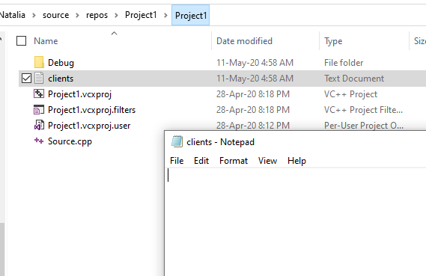
File opened (file does not exist!)
Before running code
After running code

Slide 25


File opened (file exists with some data!)
The data got truncated!
Before running code
After running code

Slide 26
Suppose we want to not truncate the data..instead we want to append the data to existing data! We need to use ios::app mode!

Slide 27
C++ allows you to use more than one file modes
You need to separate the files modes by a “|” sign!
#include<iostream>
#include<fstream>
using namespace std;
int main()
{
ofstream out("clients.txt", ios::out| ios::app);
return 0;
}

Slide 28
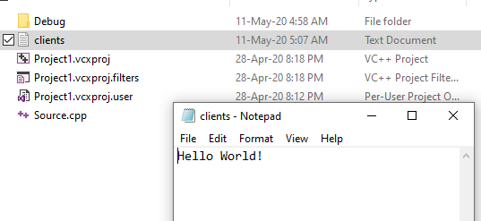

The data is not truncated! The file pointer will point after the last character “!” i.e. at EOF
Before running code
After running code
Any text you write in file will go at the end of existing text (Hello World!)

Slide 29
Closing a file
It is mandatory and preferred to ALWAYS close a file after using it (either for Input or for Output)
outClientFile.close();
#include<iostream>
#include<fstream>
using namespace std;
int main()
{
ofstream out("clients.txt", ios::out| ios::app);
out.close();
return 0;
}

Slide 30
Open function
We just covered how to open a file for I/O
The method that we covered is called “constructor method”
There is also another way to open a file. That is done using open function..

Slide 31
Open a file using open function
Same as:
#include<iostream>
#include<fstream>
using namespace std;
int main()
{
ofstream out("clients.txt", ios::out| ios::app);
out.close();
return 0;
}
#include<iostream>
#include<fstream>
using namespace std;
int main()
{
ofstream out;
out.open("clients.txt", ios::out | ios::app);
out.close();
return 0;
}
Same goes for opening a file for input!

Slide 32
End

